Slide 1
Killing Two Birds with One Stone: Cloud Bursting
Kim F. Wong
Center for Research Computing

Slide 2
Outline
Motivation
Some context on why we are asking what we are asking
Describe the proposed solution and what we aim to achieve
The status of the project
Acknowledgements

Slide 3
Motivation: Everyone is talking about Cloud Computing
Some people refer to the cloud as a disruptive democratizing innovation
The industry and government sectors are big adopters of the cloud
Enterprise IT is also a big user of the cloud
Research computing in academia, however, is slow to adopt the cloud
Why is research computing hesitant about the cloud?
Misconception Misunderstanding about the cost.
Our processes already work, so why learn something new?
How are we going to support our users in the cloud?

Slide 4
A bit of context to start the conversation
PhD in Chemical Physics
10+ years in HPC, systems administration, scientific code development
Domain expertise in condensed-phase molecular simulations and agent-based disease modeling
I’m 1 of 5 PhD research faculty consultants at the Center for Research Computing. We are Pitt’s research computing facilitators.
Rest of team: 3 leaders, a communications and outreach person, a help desk analyst, a technical lead, an administrator, a student intern, and 3 sys admins from Pitt IT

Slide 5
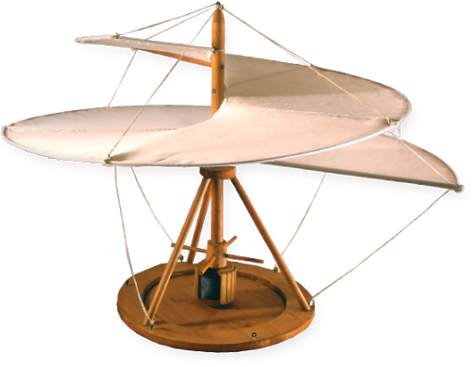
Why do we do what we do?
discovery
Innovation
CDS&E
Experiment
Theory
“… to out-compete, we must out-compute”

Slide 6
But we are more than a mere cycle shop
The mission of Pitt CRC is to increase the research productivity of our community through advanced computing. We fulfill this by:
Offering access to cutting-edge hardware and software for enabling transformative research.
Providing training workshops on the most effective ways to utilize these resources.
Providing personalized consultation on improving projects at the computational code or workflow levels.

Slide 7
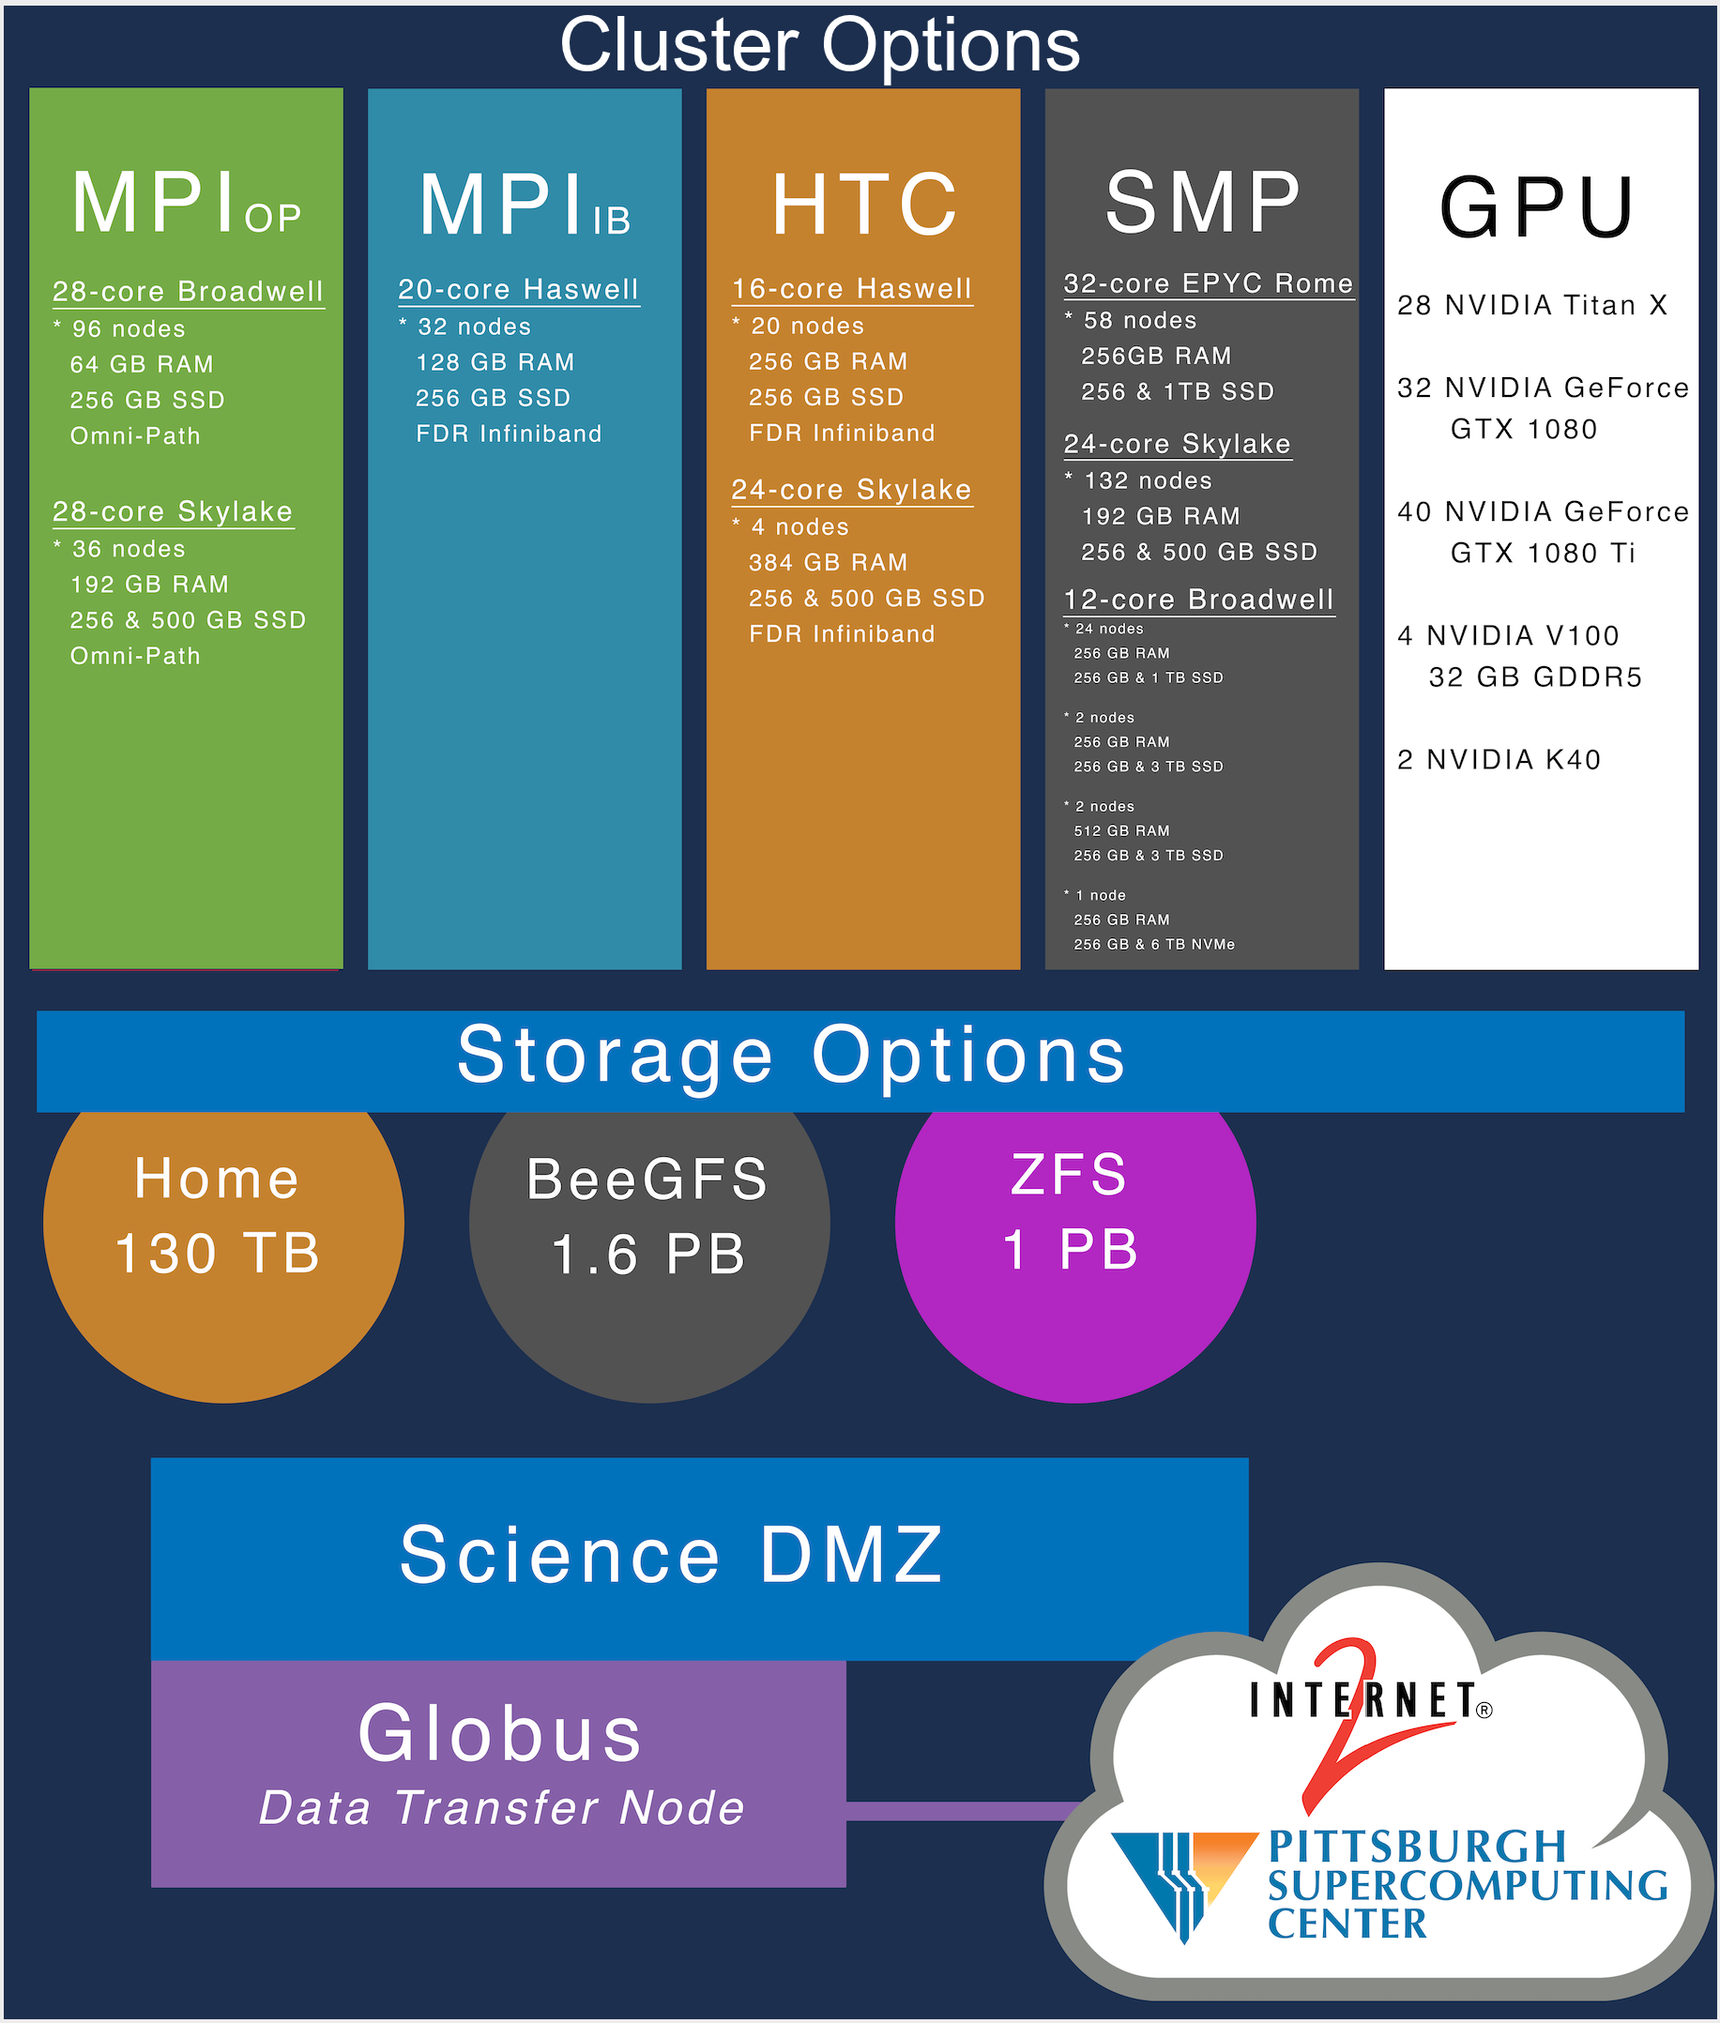
The hardware is only 1/3 of our mission.

Slide 8
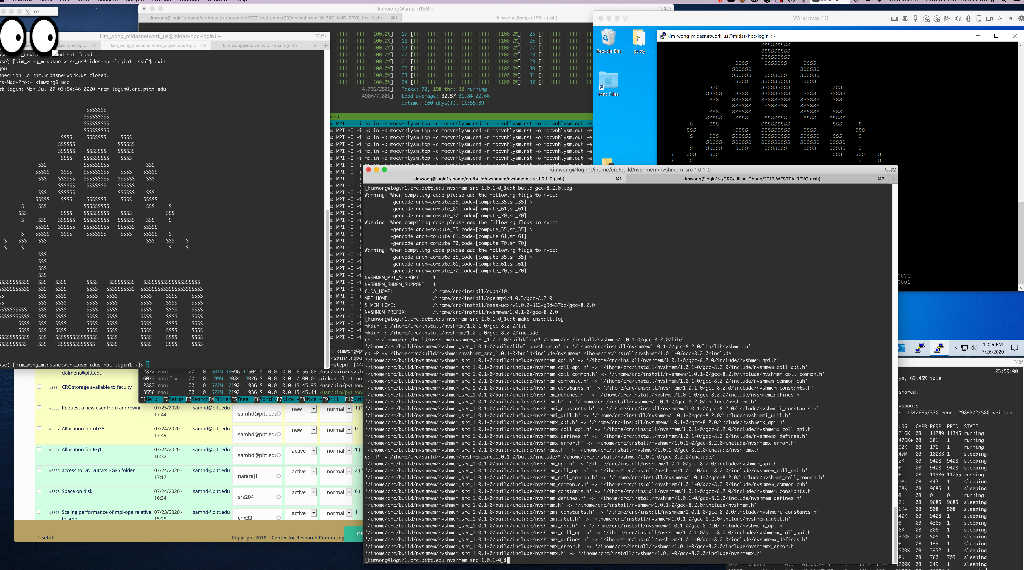
A peak at my day job: all facilitation

Slide 9
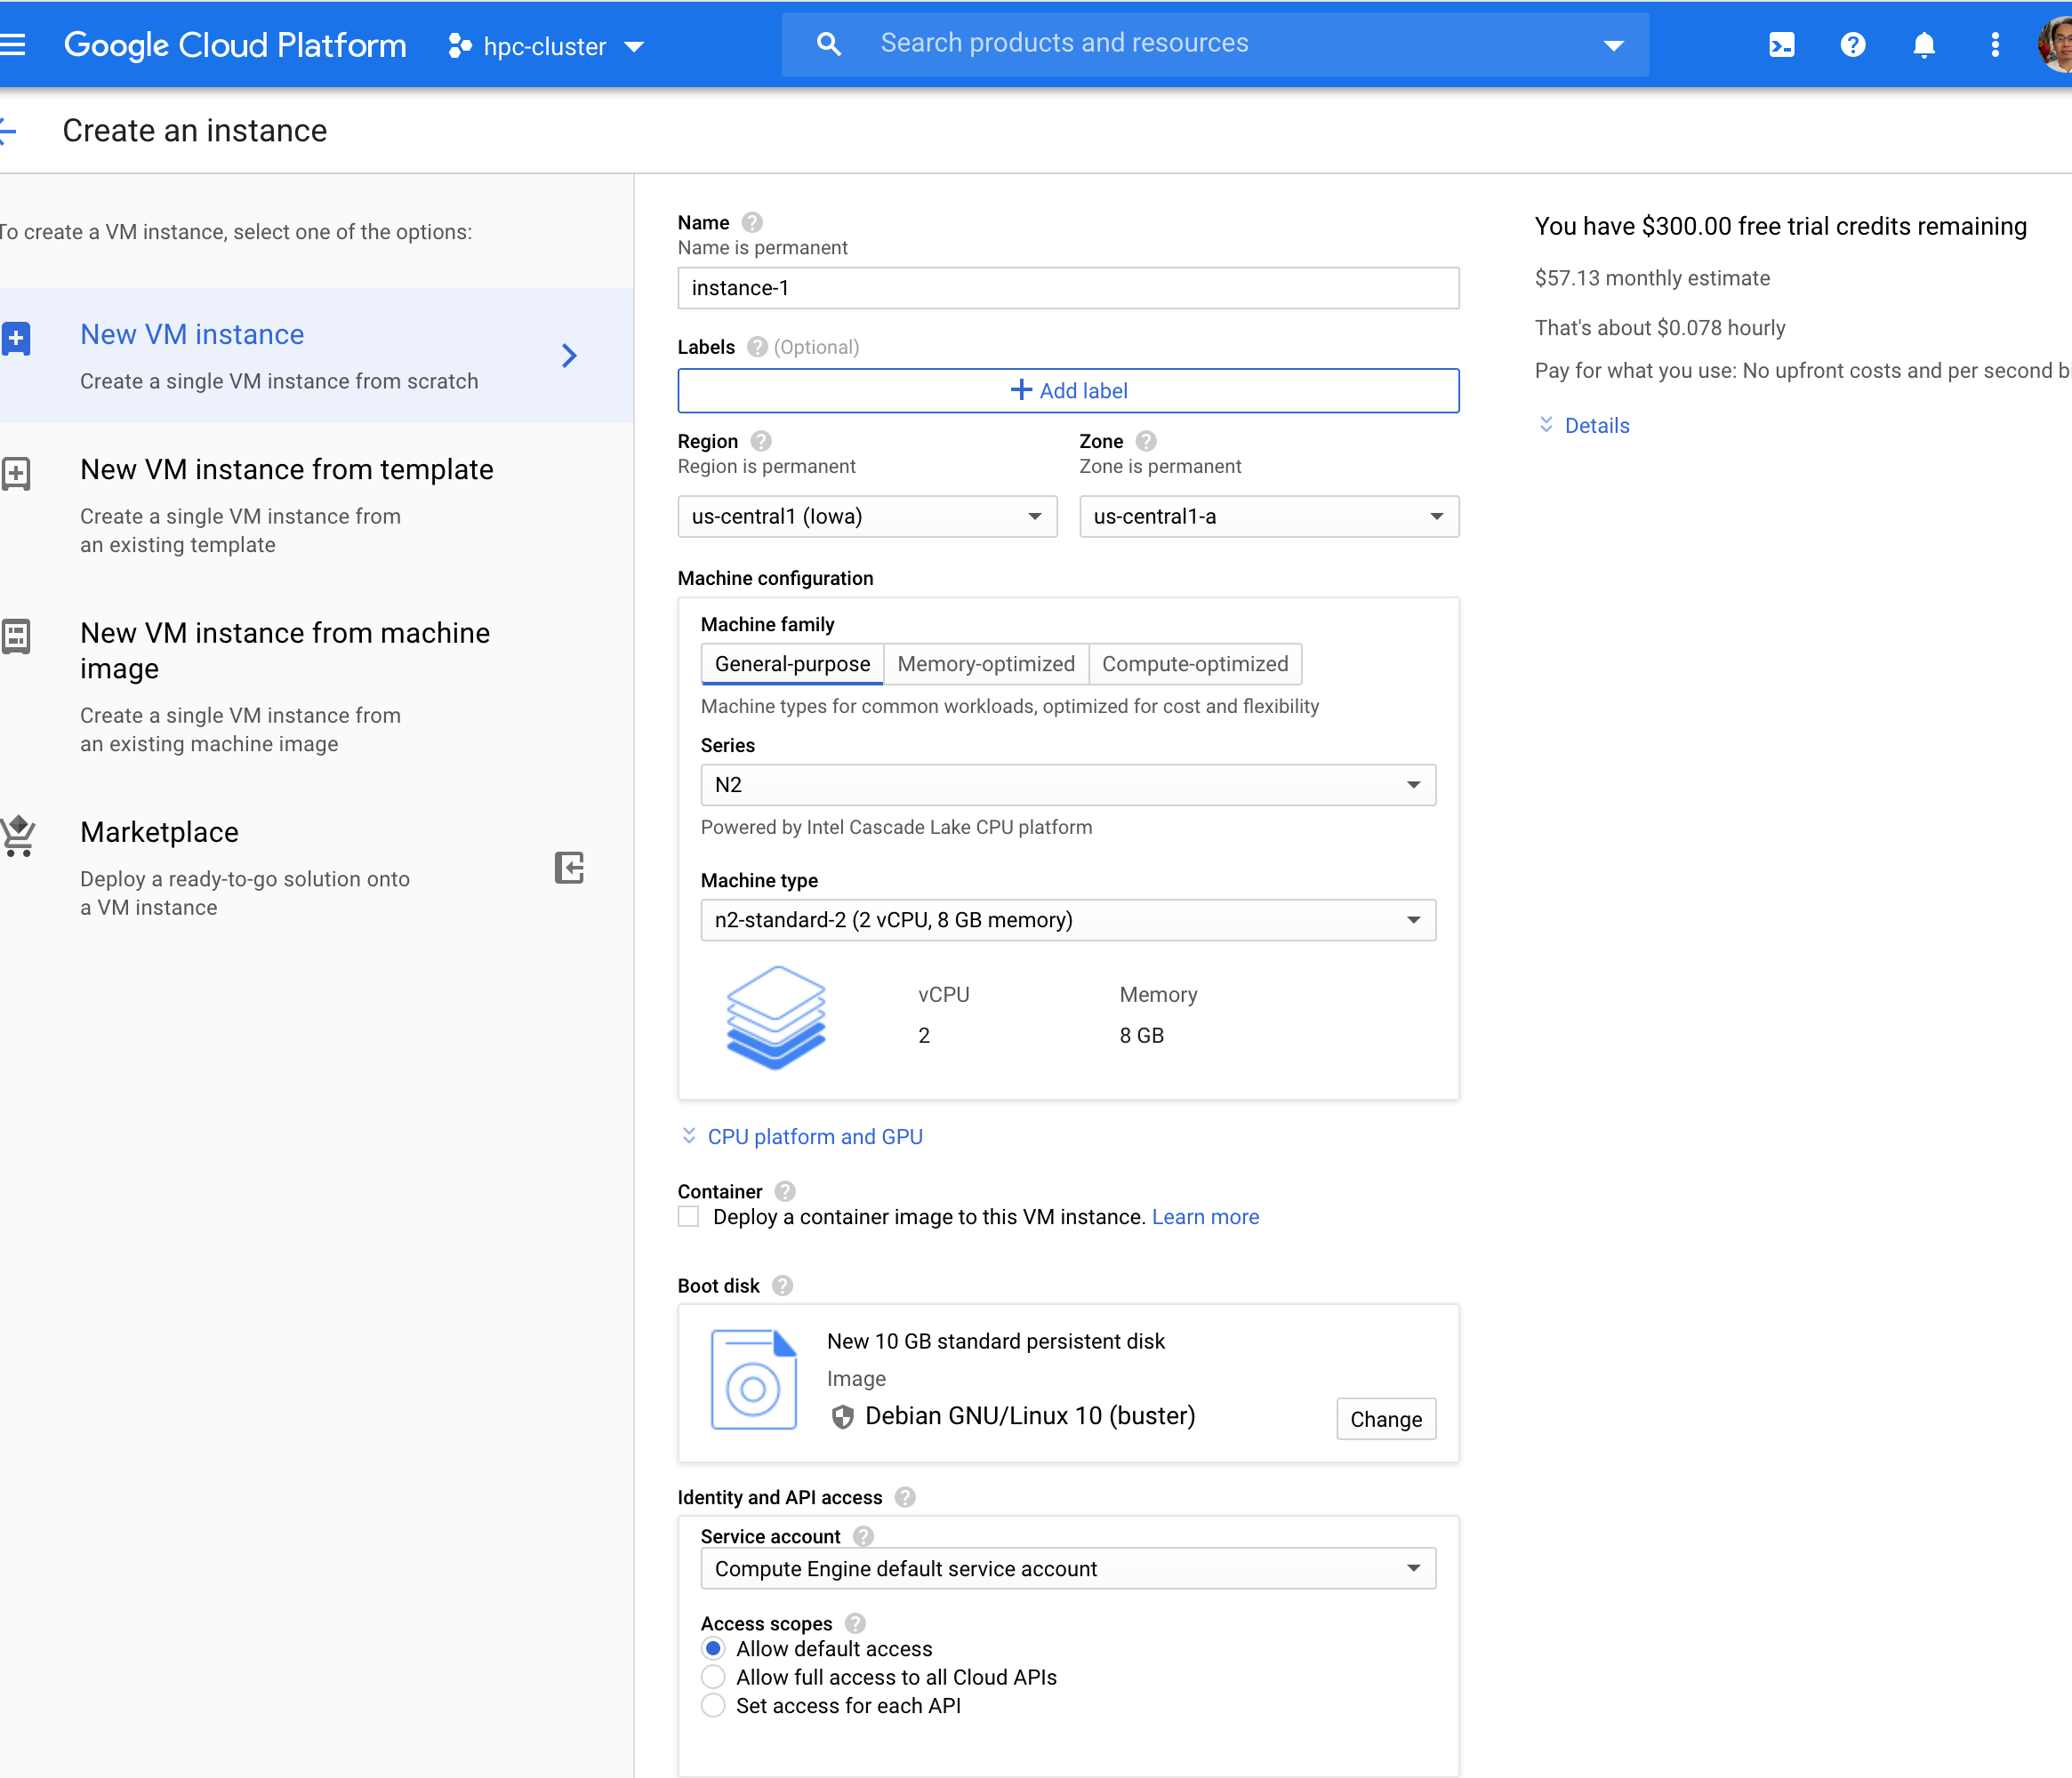
Already busy supporting local cluster, you also want the cloud?
The cloud is great & powerful.
With great power comes great responsibility.
Can you hire 2 additional people to take on the responsibility?
The facilitation will take up significant personnel time.
The key is to find a way to minimize the personnel cost while offering access to cloud technologies.

Slide 10
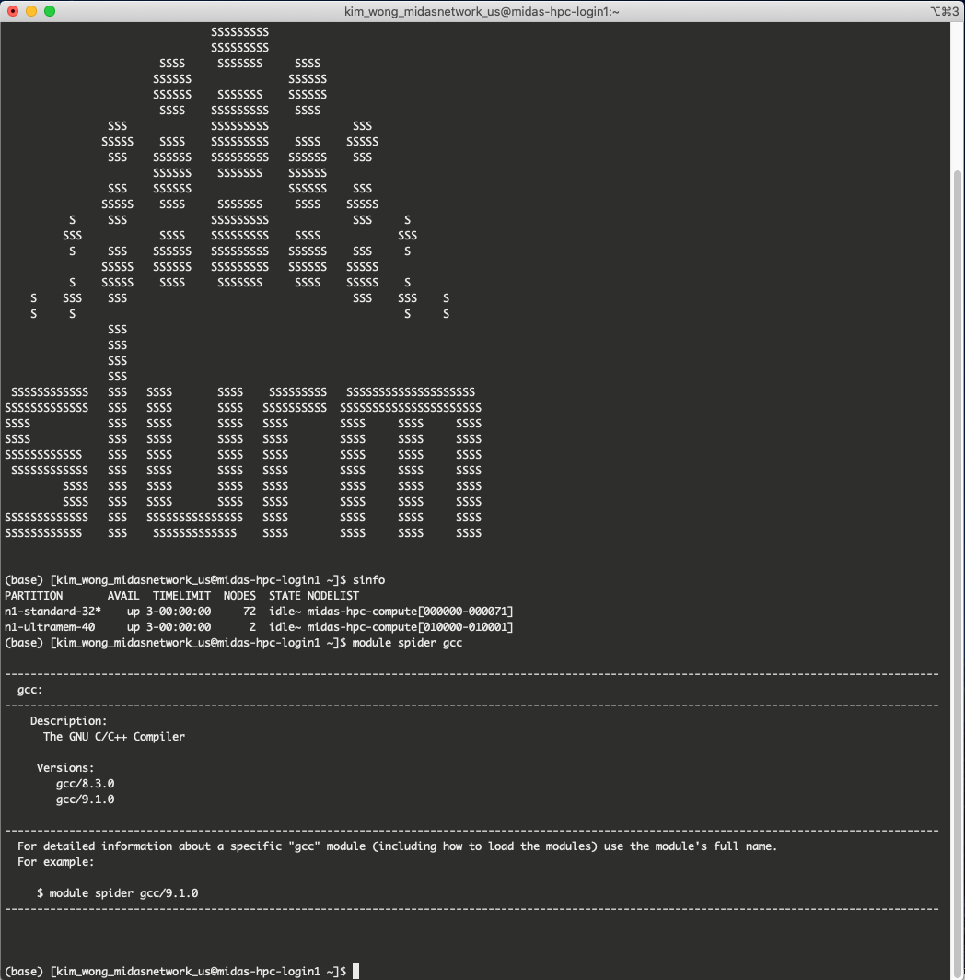
Now, it is routine to create an off-prem cluster in the cloud
MIDAS Network Coordination Center HPC cluster
Obviously, it’s a SLURM cluster
Lives in Google Cloud
Also, LMOD appears to be used for the packages
Facilitation means that I provide user support for this cluster

Slide 11
If only there is a way to make the user experience the same for on-prem and in the cloud
I recall hearing a talk on cloud bursting while at the Supercomputing Conference.
I thought it was a swell idea at the time but did not quite appreciate the practical implications.
Now what do I mean by “two birds with one stone”?
Stone == cloud bursting
Bird 1 == user support and facilitation for on-prem compute resources
Bird 2 == user support and facilitation for cloud resources
Hardware scales out easier with increasing $ compared to facilitation expertise because there is a real shortage of experienced computational scientists.

Slide 12
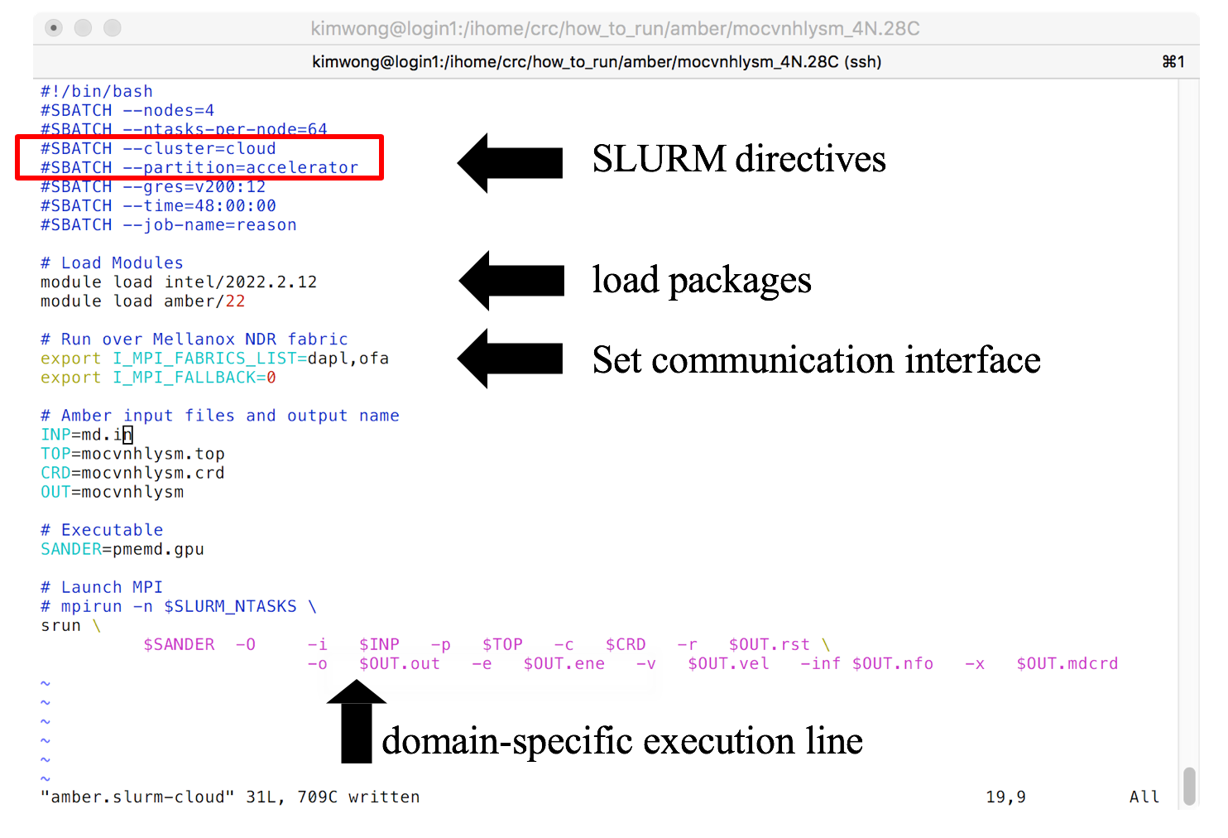
What is cloud bursting?
directive-based bursting: useful for accessing hardware not available on-premise

Slide 13
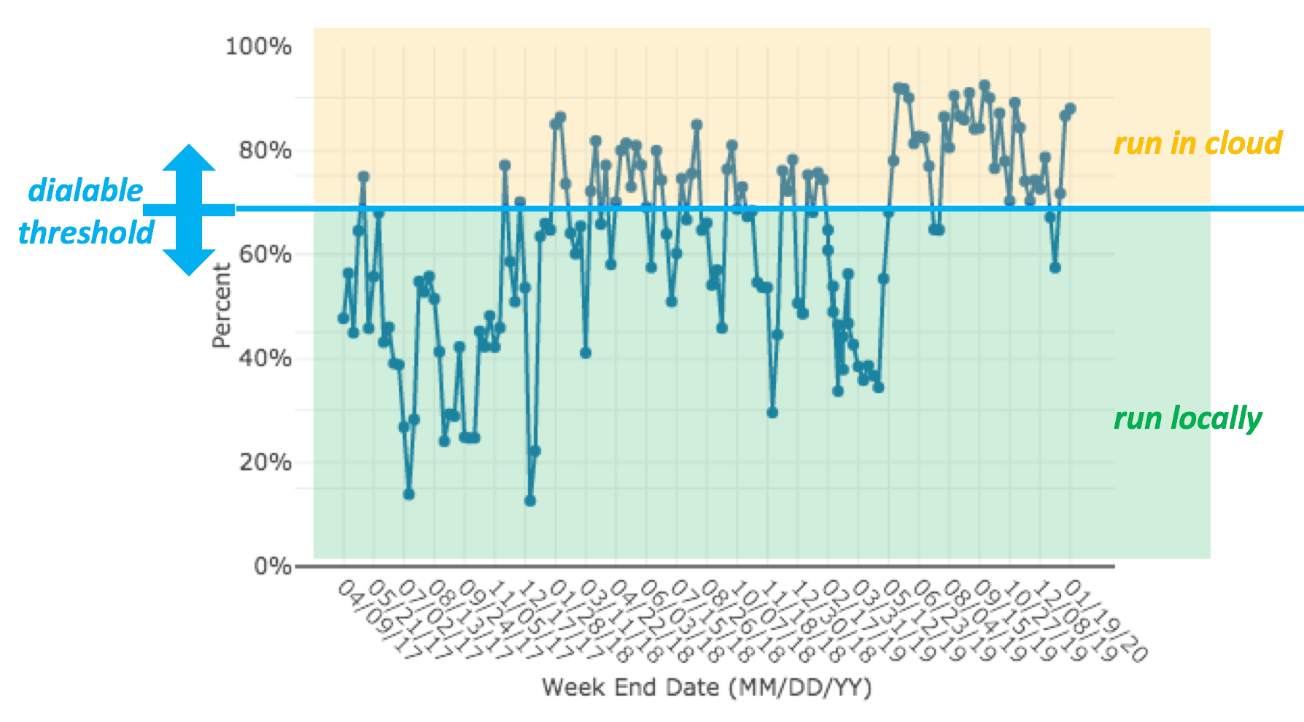
What is cloud bursting?
threshold-based bursting: useful for accessing additional resources due to high utilization at on-prem cluster

Slide 14
Goals of project
Enable cloud bursting from on-prem cluster to multiple cloud vendors, including Microsoft Azure, Google Cloud, and Amazon EC2
Use cloud bursting as a tool to directly address the topic: Why is research computing hesitant about the cloud?
Misconception Misunderstanding about the cost Obtain cost comparison between on-prem vs cloud for several representative computational workflows
Our processes already work, so why learn something new? Demonstrate from first-hand experience that on-prem skillset translates to cloud proficiency in a straightforward manner, so go ahead and learn something new.
How are we going to support our users in the cloud? Re-use existing support channels and training workshops, with expanded content, for the cloud.

Slide 15
Current Status
We have a prototype setup capable of bursting from our test SLURM cluster to Microsoft Azure
Currently working on the prototype for bursting to Google Cloud
We have identified several workflows as benchmarks for on-prem vs cloud cost comparison: (1) a genomics pipeline, (2) Amber MD and TensorFlow on GPU nodes, (3) CP2K on MPI nodes, and (4) Matlab on multi-core shared memory nodes.
Working on containerization strategy. Current prototype deployment leverages LMOD for provisioning packages but we should plan on containerizing the 400+ packages.

Slide 16
Acknowlegements
HARC for supporting my time to explore using cloud for research computing
Google for $5K credit to prototype cloud bursting
Pitt IT for footing the bill for Azure credits to prototype cloud bursting
Azure CycleCloud for professional engagement to help prototype cloud bursting

